Slide 1
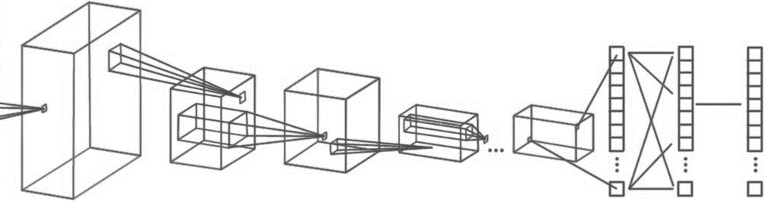
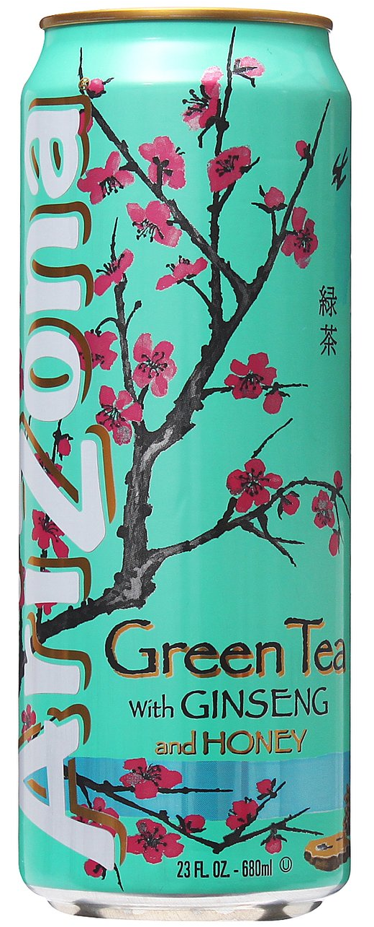

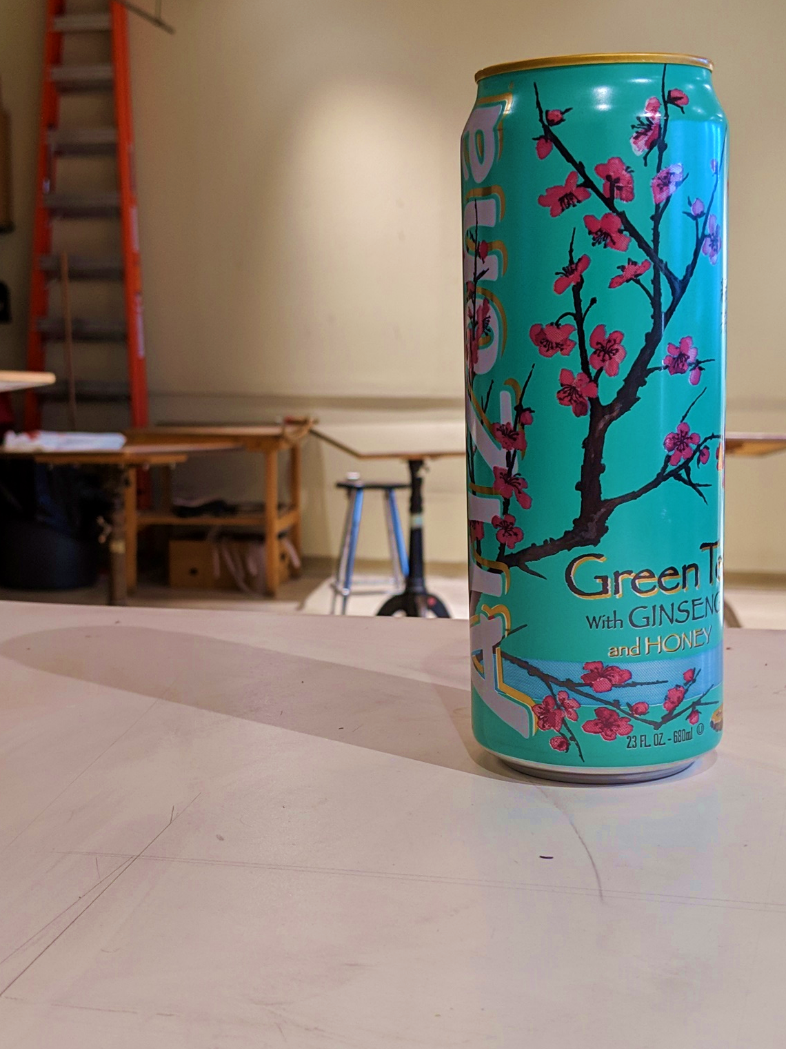
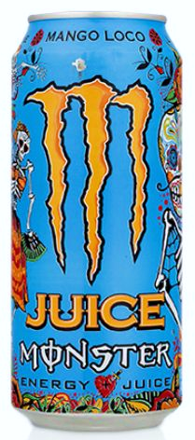
Department of Electrical and Computer Engineering
Computer Engineering 186
Spring 2019
Alexis J. Renderos, William Lavelle, Rolf Anderson, Ritvik Maripally
Adaptive Visual Target Identification and Tracking through
Convolutional Neural Network (CNN) based Machine Learning and Computer Vision
Abstract
The aim of this project is to identify a chosen object of interest at range using a camera feed and an image processing algorithm to assist in the detection, identification and tracking of the target.
Image Processing
The aim of this project is to identify a chosen object of interest at range using a camera feed and an image processing algorithm to assist in the detection, identification and tracking of the target. It is expected that the object of interest has already been analyzed prior to identification attempts, and that the target is in the field of view of the camera.
Image Processing
The aim of this project is to identify a chosen object of interest at range using a camera feed and an image processing algorithm to assist in the detection, identification and tracking of the target. It is expected that the object of interest has already been analyzed prior to identification attempts, and that the target is in the field of view of the camera.
Data Collection and Analysis
To properly analyze incoming image data, we must first determine the characteristics of our target. To do this, we train a Convolutional Nerual Network (CNN) on a series of photos of what the subject looks like. The three chosen targets (Fig 1) were then photographed and fed into the CNN.
Target Identification
The aim of this project is to identify a chosen object of interest at range using a camera feed and an image processing algorithm to assist in the detection, identification and tracking of the target. It is expected that the object of interest has already been analyzed prior to identification attempts, and that the target is in the field of view of the camera.
INPUT
CONVOLUTION + RELU POOLING
CONVOLUTION + RELU POOLING …
FLATTEN
FULLY
CONNECTED
SOFTMAX
FEATURE LEARNING
CLASSIFICATION
Acknowledgements

